Slide 1
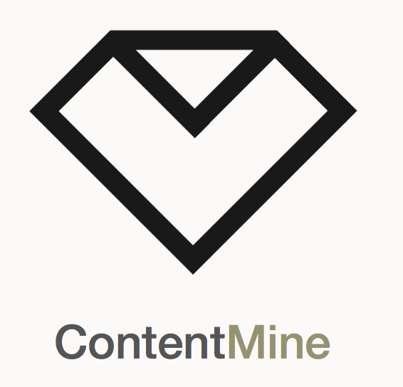




Scientific Ontologies in the Digital Age
Peter Murray-Rust
University of Cambridge
collaborators
Matthew Dunstan (Cambridge) ,
Shweata N Hegde (NIPGR)
OMDI2021 , 2021-10-05
Talk will show a range of ontologies, demos, software, and suggestions for discussion.
pm286@cam.ac.uk
peter@contentmine.org
Images from ContentMine CC BY and Wikimedia CC BY-SA

Slide 2
Ontologies support a
Computable Reusable
Object Narrative

Slide 3
Notes
Ontologies are relevant to all fields, not just materials, so this talk is multidisciplinary
The software and techniques shown are very widely applicable
All ontologies must aim to be FAIR, and frictionless (helpful, no login).
Ontologies need software. They are computable and merge into objects and declarative programs.

Slide 4
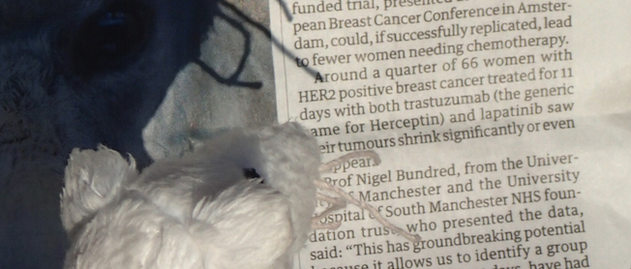
What do these mean?
Receptor
Drug
Drug
Computable Reusable Object Narrative

Slide 5
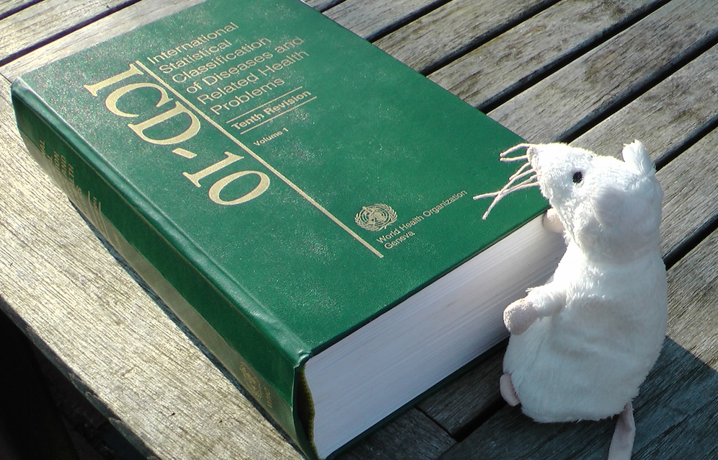
What’s an Ontology? And its purpose?
Purposes:
ICD-10 for national reporting every disease/condition
ICD-10-CM diagnosis and insurance (USA)
We use Dictionary == Ontology

Slide 6
Why ontologies?
Explanation, translation, to humans
Data validation e.g. CIF, crystallography
Data transformation , CML[1] comp. chemistry
Linking to Linked Data Cloud
Mining documents by words, e.g. lithium battery
Mining documents by data, e.g. cell dimension
Contractual process (ICD-10-CM) US insurance
Sociopolitical (DSM). Linguistic research gender
[1] Chemical Markup Language (Computable Reusable Object Narrative)

Slide 7
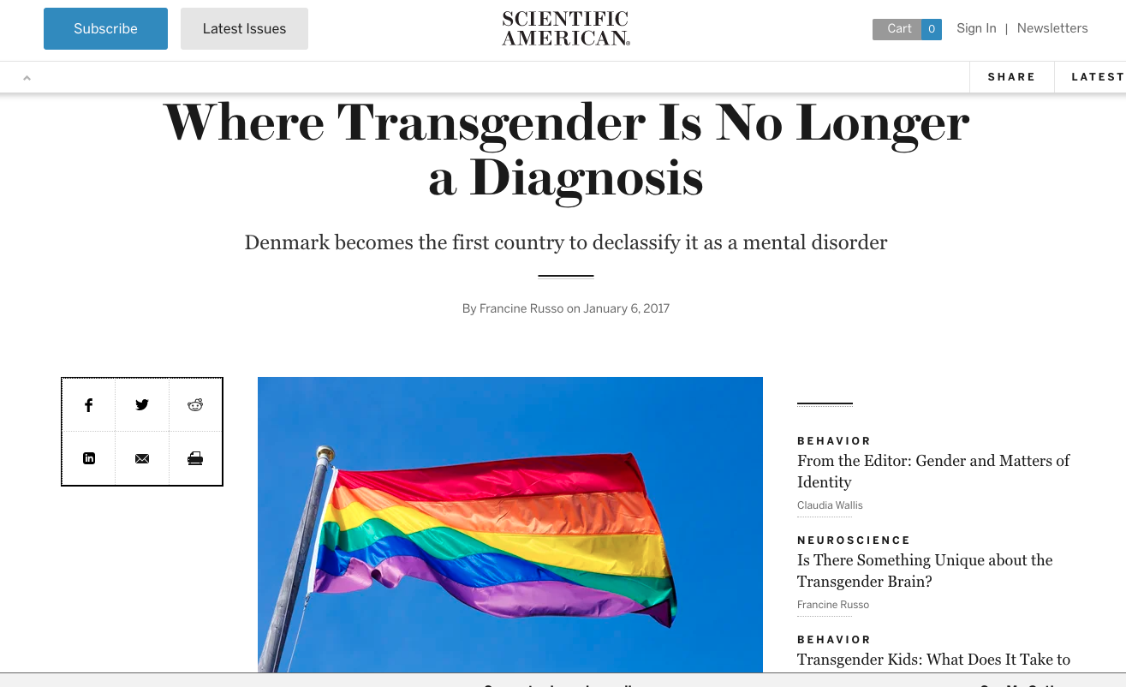
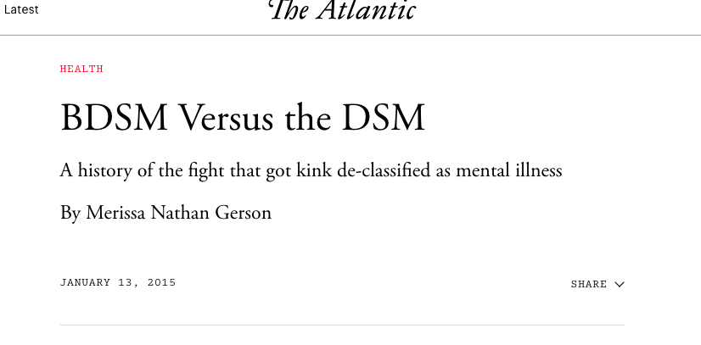
Ontologies constrain/enhance the way we think and talk
Diagnostic and Statistical Manual of Mental Disorders

Slide 8
Where do ontologies come from?
Authoritative bodies
Government and NGO (CERN, NIH, EBI, Brookhaven)
Learned societies (IUCr)
Major labs
Industry
Community
Researchers [1]
Wikidata
Long-term ontologies come from years of dedicated human effort, especially as support is needed. Adoption requires consistency, running code, tutorials, support, users
[1] In our current projects (e.g. battery materials, or terpene synthases) we use multiple rapid small linked dictionaries and Wikidata

Slide 9
Ontologies in practice

Slide 10
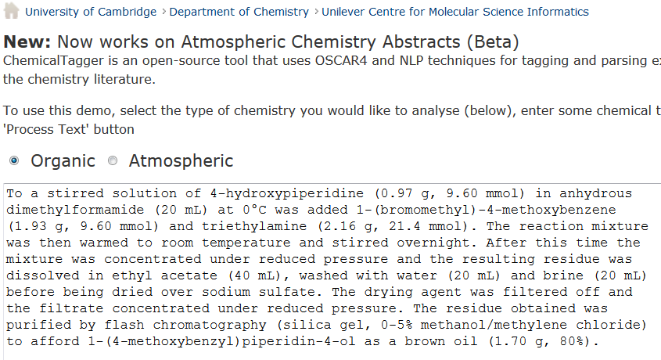
http://chemicaltagger.ch.cam.ac.uk/
Typical
Typical chemical synthesis
This contains several small annotating and parsing ontologies

Slide 11
http://chemicaltagger.ch.cam.ac.uk/
Typical
Typical chemical synthesis
This contains several small annotating and parsing ontologies

Slide 12
Materials discourse
SCIENTIFIC REPORTS | 4 : 5694 | DOI: 10.1038/srep05694
The syntheses of NiO and LiNi 0.4Mn 0.4Co 0.18Ti 0.02O 2 (NMC) were performed according to previously developed protocols 56. In short, NiO was synthesized using a solvothermal method aided with an alcohol pseudo-supercritical drying technique. NMC was synthesized using a co-precipitation method followed by high-temperature annealing with LiOH. 2032 Coin cells were fabricated using composites of NiO or NMC as working electrodes and lithium metal foils as counter electrodes. The NiO working electrodes were composed of 80 wt.% active material, 10 wt.% polyvinylidene fluoride (Kureha Chemical Ind. Co. Ltd) and 10 wt.% acetylene carbon black (Denka, 50% compressed) and loadings were typically 12 mg/cm 2 of active material. To make the electrodes, these solids were mixed into N-methyl-2-pyrrolidinone and the resulting slurry cast onto copper current collectors and dried. NMC working electrodes were prepared similarly and contained 84 wt.% active material, 8 wt.% polyvinylidene fluoride, 4 wt.% acetylene carbon black and 4 wt.% SFG-6 synthetic graphite on carbon-coated aluminum current collectors, with typical active material loadings of 67 mg/cm 2. The coin cells were assembled in a helium-filled glove box using Celgard 2400 separators and 1 M LiPF6 electrolyte in 1:2 w/w ethylene carbonate/dimethyl carbonate (Ferro Corporation). Battery testing was performed on a computer controlled VMP3 potentiostat/galvanostat (BioLogic). NiO and NMC electrodes were cycled at C/2 and C/20 rates, respectively. 1C was defined as fully discharging or charging an electrode in 1 h, corresponding to specific current densities of 718 mA/g and 280 mA/g for NiO and NMC materials, respectively.
Computable Reusable Object Narrative
Cut-n-paste into
http://chemicaltagger.ch.cam.ac.uk/
Written ca 2007 by Lezan Hawizy
Daniel Lowe wrote OPSIN (name to structure)

Slide 13
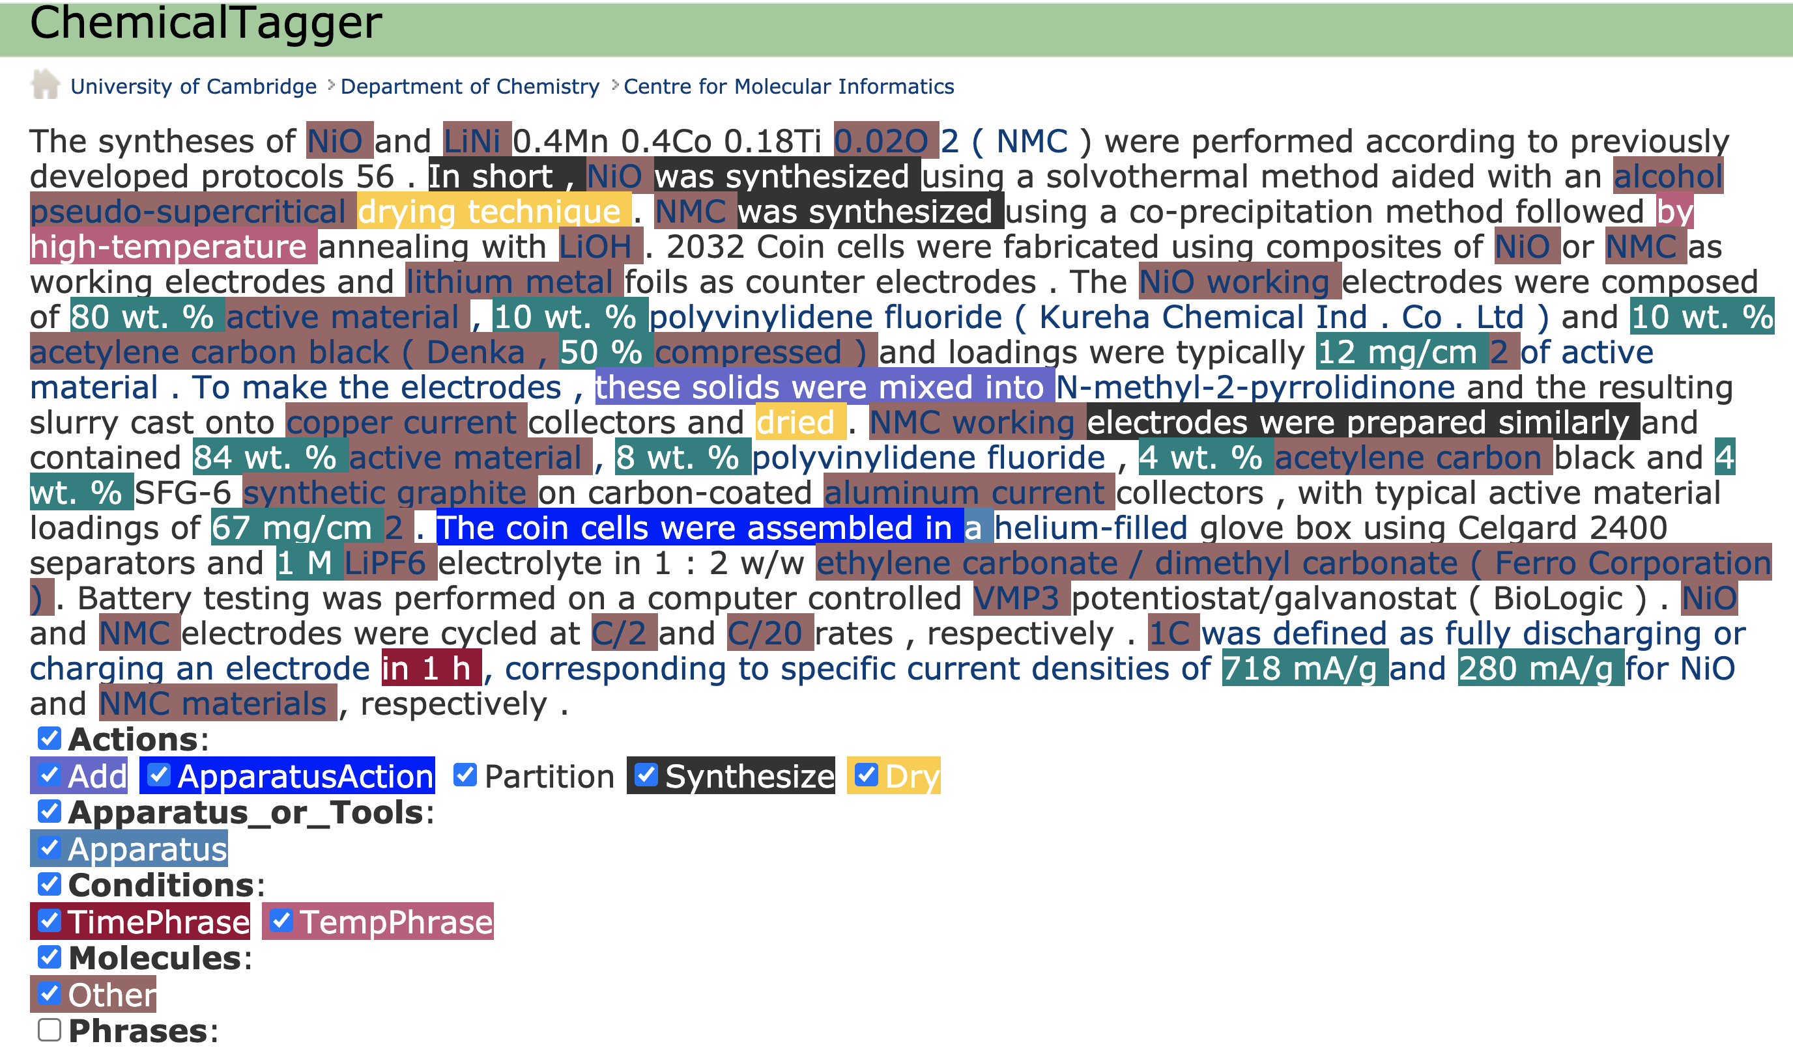
ChemicalTagger “out of the box” on Materials discourse
The unmarked fields need ontologies!

Slide 14
Crystallography: CIF where much of this began

Slide 15
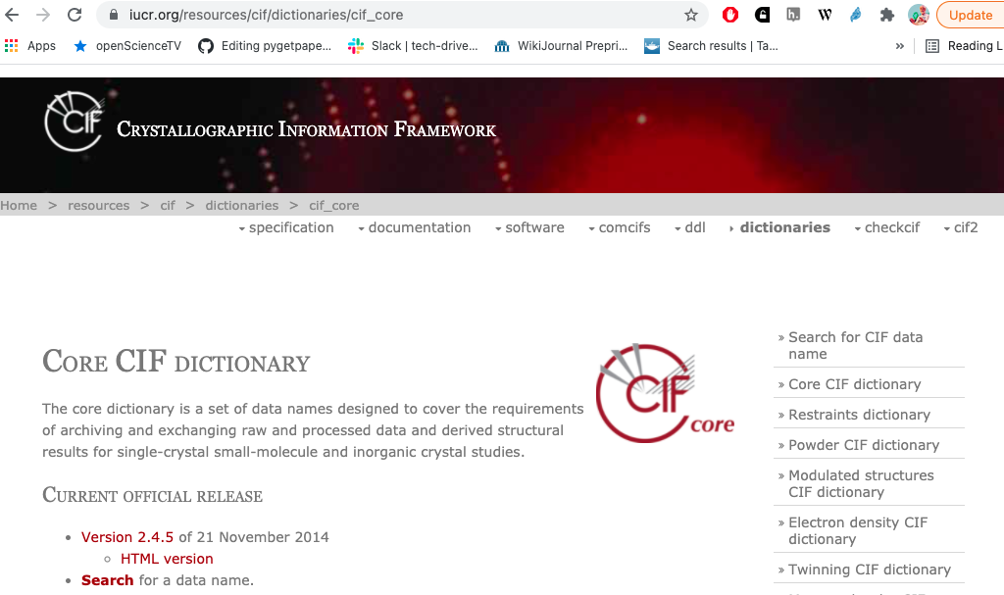
CIF: crystallographic ontology – a model beyond formats
In the late [1970s] the IUCr Commissions […] promoted the development of the Standard Crystallographic File Structure
“Framework” (model) , not “file”
[late 1980s] IUCr promoted the submission of data
in machine-readable form
30 years !
Hall SR, Allen FH, Brown ID (1991). "The Crystallographic Information File (CIF):
a new standard archive file for crystallography". Acta Crystallographica Section A. 47 (6):
655–685. doi:10.1107/S010876739101067X.

Slide 16
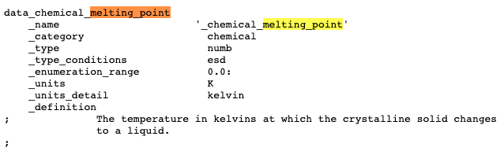
Typical CIF data entry
Container of Name-value pairs
Unique_id
Classification
Datatype
Error limits
Allowed range
Mandated units
CIF Supports:
Editing
Checking
Transformation
Human discourse
Data can be mixed with text (LaTeX)

Slide 17
Typical CIF data entry
Container of Name-value pairs
Unique_id
Classification
Datatype
Error limits
Allowed range
Mandated units
Computable Reusable Object
CIF Supports:
Editing
Checking
Transformation
Human discourse
Data can be mixed with text (LaTeX)
Computable Reusable Object

Slide 18
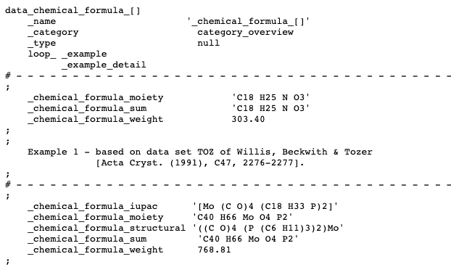

Slide 19
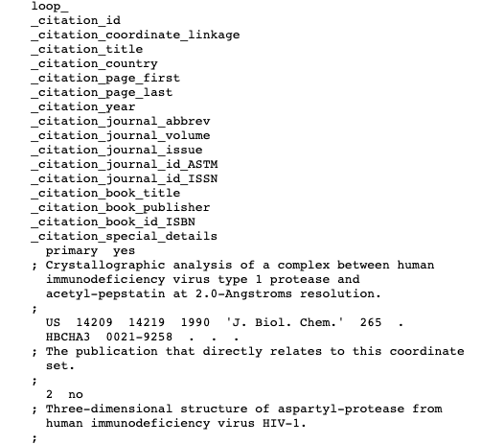
Bibliography. YOU don’t need to invent your own

Slide 20
Communal ontologies

Slide 21
DBpedia – a dataset containing extracted data from Wikipedia; it contains about 3.4 million concepts described by 1 billion triples, including abstracts in 11 different languages
GeoNames – provides RDF descriptions of more than 7,500,000 geographical features worldwide.
Wikidata – a collaboratively-created linked dataset that acts as central storage for the structured data of its Wikimedia Foundation sister projects
Global Research Identifier Database (GRID) – an international database of 89,506 institutions engaged in academic research

Slide 22
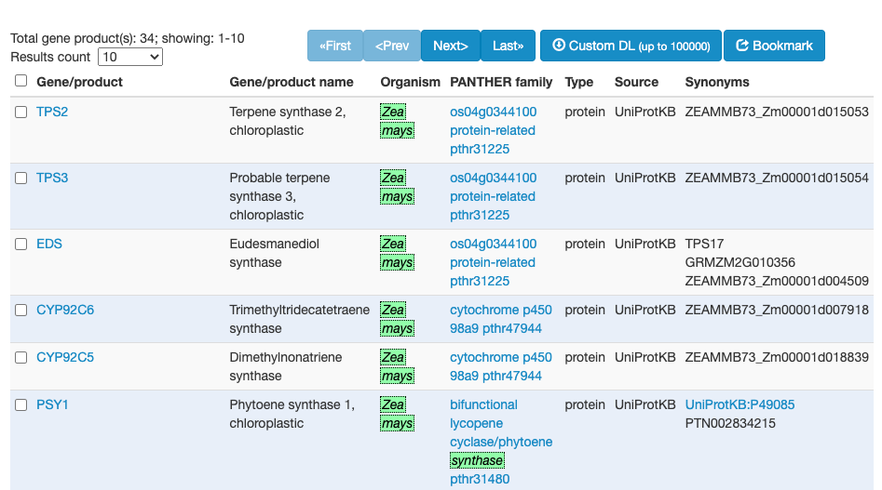
Gene Ontology (GO) and browser links Species, Genes and Proteins
Gene Product
Proteins
Maize

Slide 23
Wikidata in Linked OpenData cloud

Slide 24
Wikidata in Linked OpenData cloud
Computable Reusable Objects

Slide 25
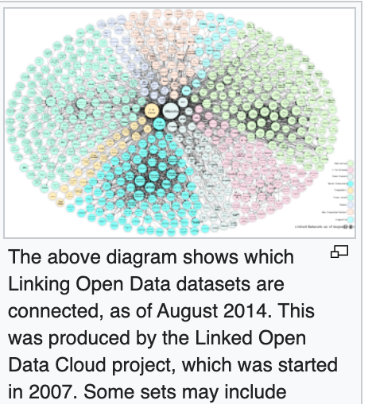
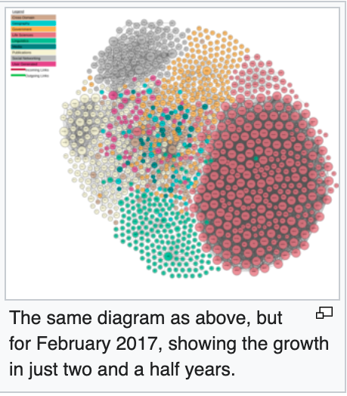
https://en.wikipedia.org/wiki/Linked_data

Slide 26
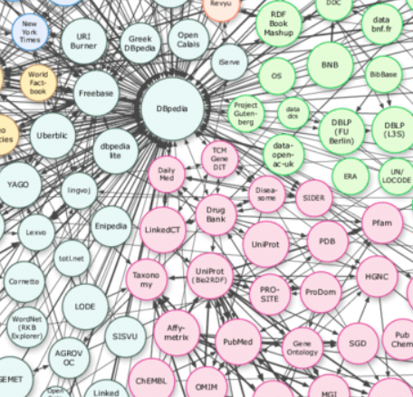
DBPedia 2007
Collection of
links in Wikipedia
DBpedia
Computable Reusable Objects
Drugbank
UniProt
PDB
Gene
Ontolopgy
PubChem
ChEMBL

Slide 27
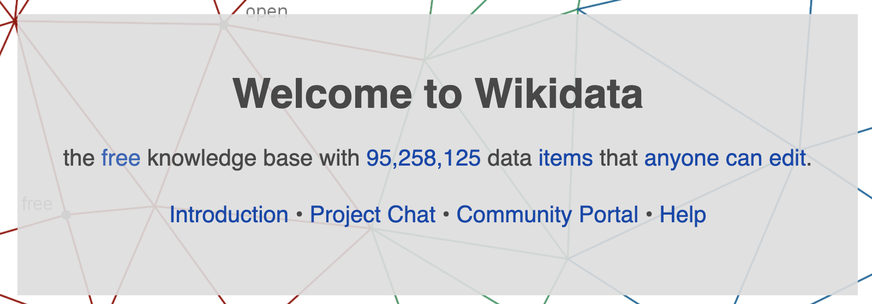
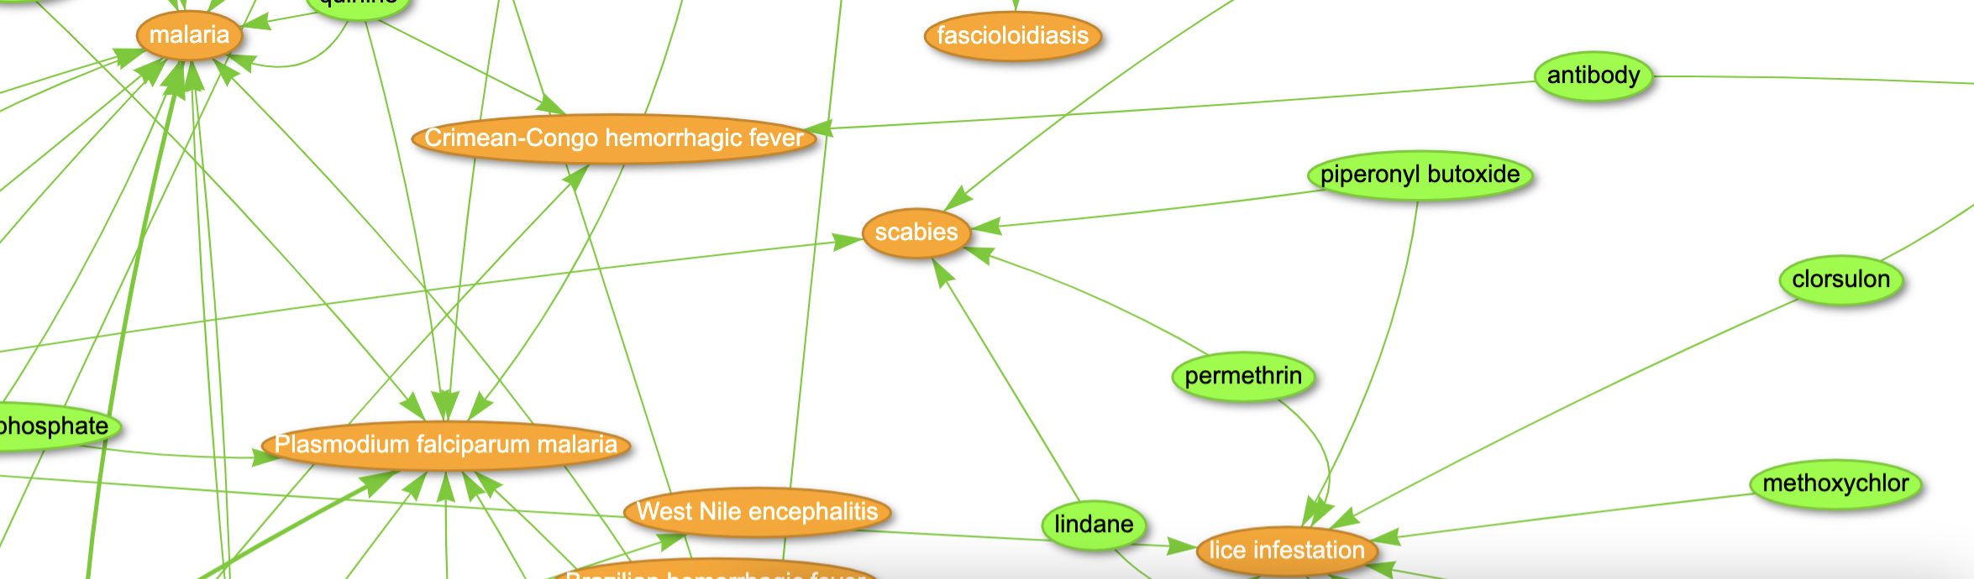
https://query.wikidata.org/
https://query.wikidata.org/#%23A%20network%20of%20Drug-disease%20interactions%20on%20infectious%20diseases%20%28Source%3A%20Disease%20Ontology%2C%20NDF-RT%20and%20ChEMBL%29%0A%23defaultView%3AGraph%0ASELECT%20DISTINCT%20%3Fitem%20%3FitemLabel%20%3Frgb%20%3Flink%0AWHERE%0A%7B%0A%20%20VALUES%20%3Ftoggle%20%7B%20true%20false%20%7D%0A%20%20%3Fdisease%20wdt%3AP699%20%3Fdoid%3B%0A%20%20%20%20%20%20%20%20%20%20%20wdt%3AP279%2B%20wd%3AQ18123741%3B%0A%20%20%20%20%20%20%20%20%20%20%20wdt%3AP2176%20%3Fdrug.%0A%20%20%3Fdrug%20rdfs%3Alabel%20%3FdrugLabel.%0A%20%20%20%20FILTER%28LANG%28%3FdrugLabel%29%20%3D%20%22en%22%29.%0A%20%20%3Fdisease%20rdfs%3Alabel%20%3FdiseaseLabel.%0A%20%20%20%20FILTER%28LANG%28%3FdiseaseLabel%29%20%3D%20%22en%22%29.%0A%20%20BIND%28IF%28%3Ftoggle%2C%3Fdisease%2C%3Fdrug%29%20AS%20%3Fitem%29.%0A%20%20BIND%28IF%28%3Ftoggle%2C%3FdiseaseLabel%2C%3FdrugLabel%29%20AS%20%3FitemLabel%29.%0AGraph%0A%0A%20%20BIND%28IF%28%3Ftoggle%2C%22FFA500%22%2C%227FFF00%22%29%20AS%20%3Frgb%29.%0A%20%20BIND%28IF%28%3Ftoggle%2C%22%22%2C%3Fdisease%29%20AS%20%3Flink%29.%0A%7D
#A network of Drug-disease interactions on infectious diseases (Source: Disease Ontology, NDF-RT and ChEMBL)
#defaultView:Graph
SELECT DISTINCT ?item ?itemLabel ?rgb ?link
WHERE
{
VALUES ?toggle { true false }
?disease wdt:P699 ?doid;
wdt:P279+ wd:Q18123741;
wdt:P2176 ?drug.
?drug rdfs:label ?drugLabel.
FILTER(LANG(?drugLabel) = "en").
?disease rdfs:label ?diseaseLabel.
FILTER(LANG(?diseaseLabel) = "en").
BIND(IF(?toggle,?disease,?drug) AS ?item).
BIND(IF(?toggle,?diseaseLabel,?drugLabel) AS ?itemLabel).
Graph
BIND(IF(?toggle,"FFA500","7FFF00") AS ?rgb).
BIND(IF(?toggle,"",?disease) AS ?link).
}

Slide 28
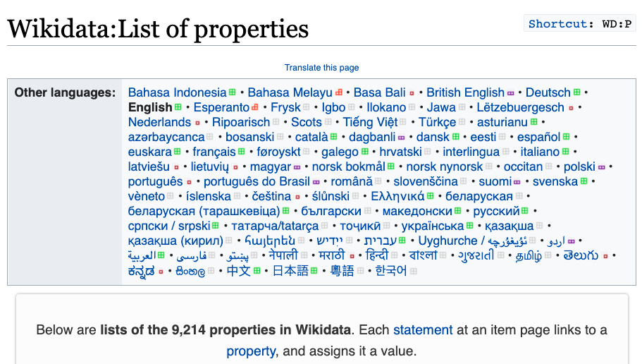
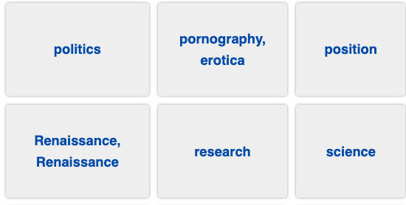

Slide 29
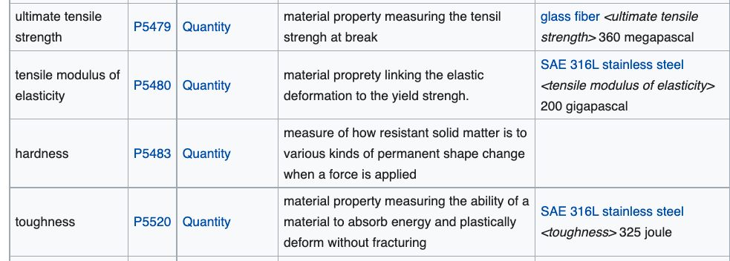
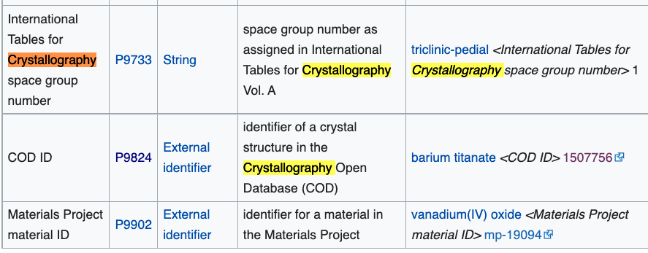

Slide 30
Search, annotation, mining

Slide 31
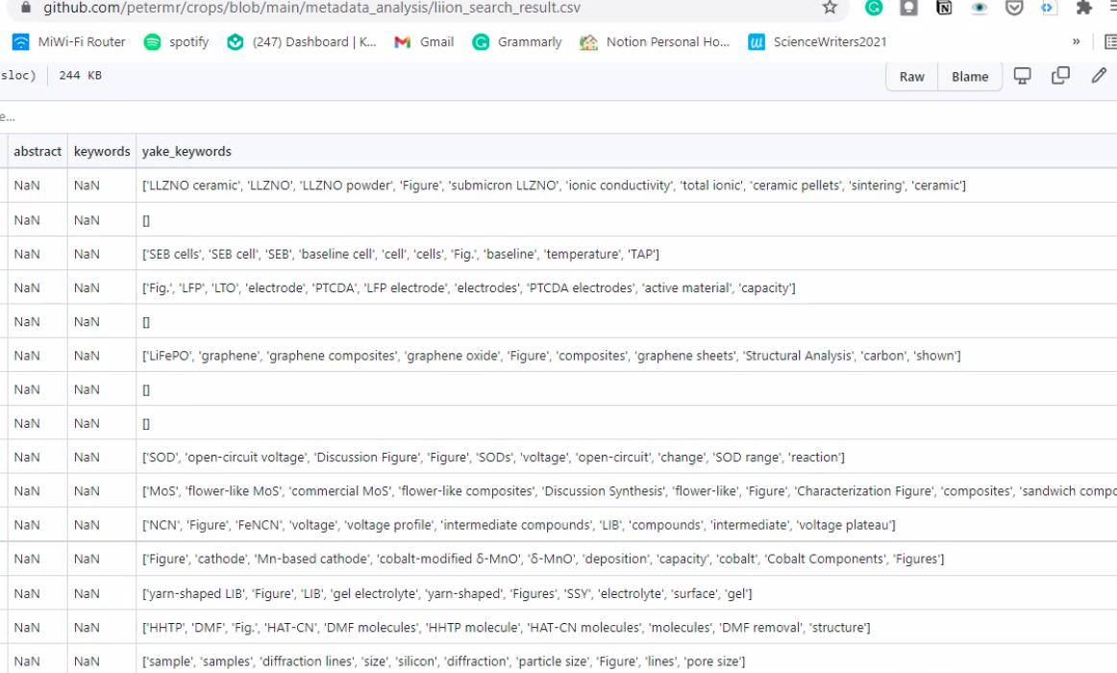
Unsupervised Extraction of phrases from 100 papers( YAKE, SciSpacy)
LLZNO ceramic
Ceramic pellets
Graphene
Active material
Open circuit
DMF molecules
Voltage plateau
(Shweata N Hegde, Mysore)

Slide 32
Unsupervised Extraction of phrases from 100 papers( YAKE, SciSpacy)
LLZNO ceramic
Ceramic pellets
Graphene
Active material
Open circuit
Computable Reusable Objects
DMF molecules
Voltage plateau
(Shweata N Hegde, Mysore)

Slide 33
We make a simple dictionary for materials
<dictionary title="materials">
<entry term="anode" wikipedia="anode" wikidata="Q181232" description="electrode through which conventional current flows into a polarized electrical device"/>
<entry term="cathode" wikidata="Q175233" description="electrode from which …"/>
<entry term="current density" wikidata="Q77680811”/> …

Slide 34
Annotation using Dictionaries
file="liion/PMC4062906/methods/search/elements/results.xml">
<result pre="foil and dried at 80°C under vacuum for 5 h." exact="Lithium" post="sheet was served as counter and reference …"/>
methods = section
PMC4062906 = reference
elements = dictionary
(annotation to W3C spec)

Slide 36
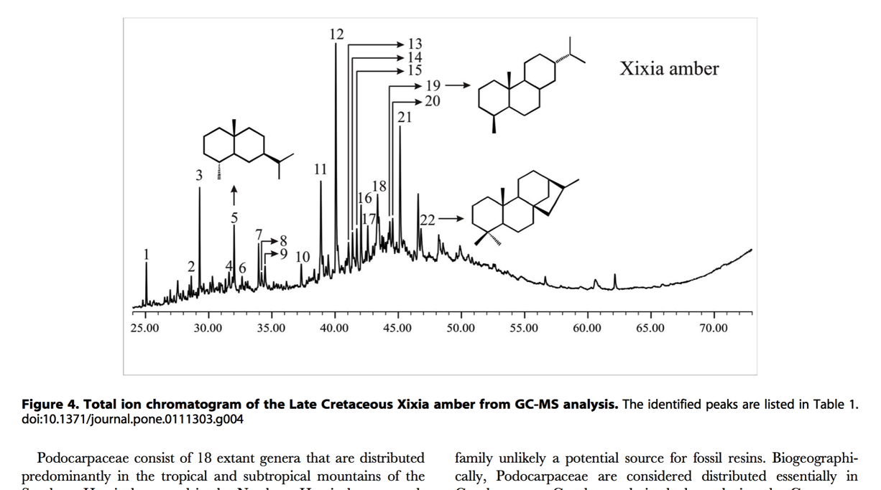
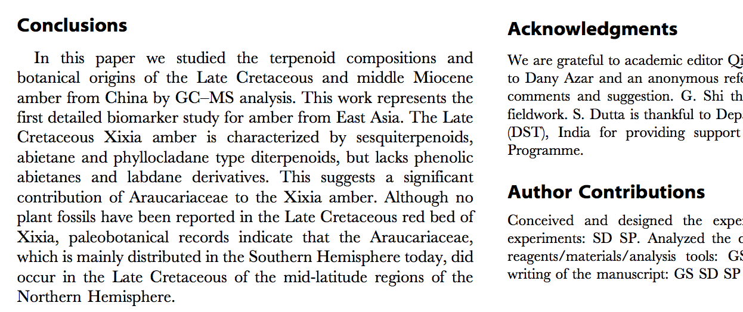
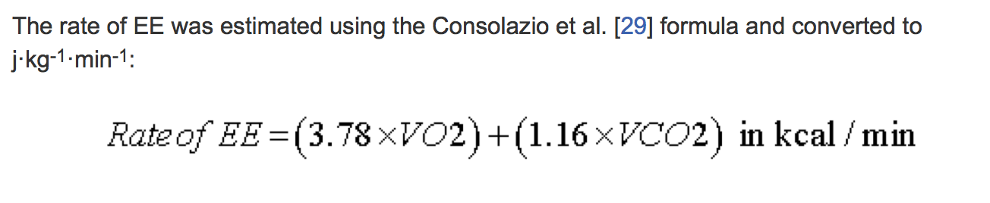
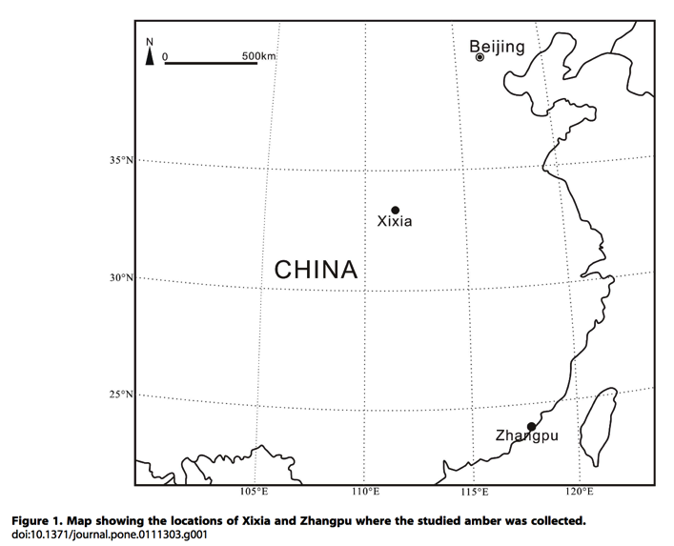
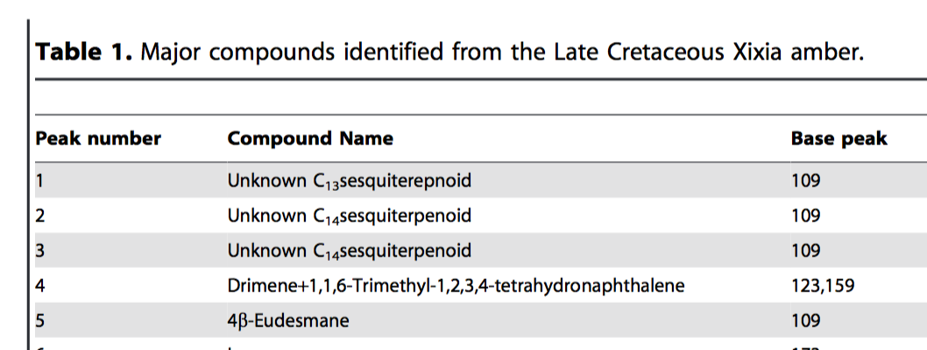
What is “Content”?
TEXT
CHEMISTRY
MATH
SECTIONS
contentmine.org tackles these
TABLES
MAPS
http://www.plosone.org/article/fetchObject.action?uri=info:doi/10.1371/journal.pone.0111303&representation=PDF CC-BY

Slide 37
What is “Content”?
CML
TEXT
CHEMISTRY
HTML
MathML
SECTIONS
MATH
Computable Reusable Objects
contentmine.org tackles these
GML
Pandas, R, etc.
TABLES
MAPS
CML
http://www.plosone.org/article/fetchObject.action?uri=info:doi/10.1371/journal.pone.0111303&representation=PDF CC-BY

Slide 38
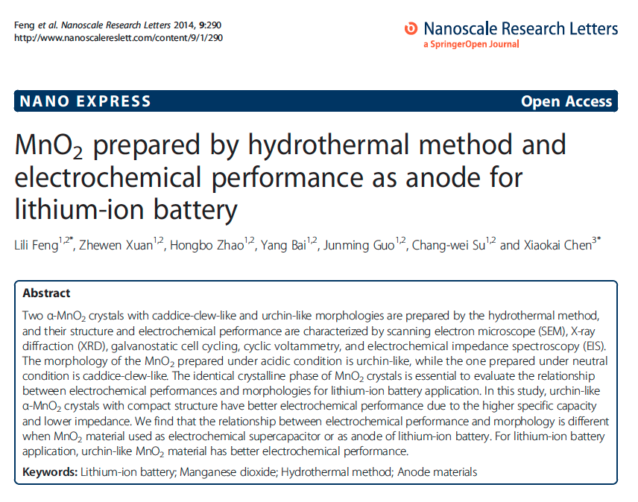
getpapers -q "lithium-ion battery" -n
info: Searching using eupmc API
info: Found 3305 open access results

Slide 39
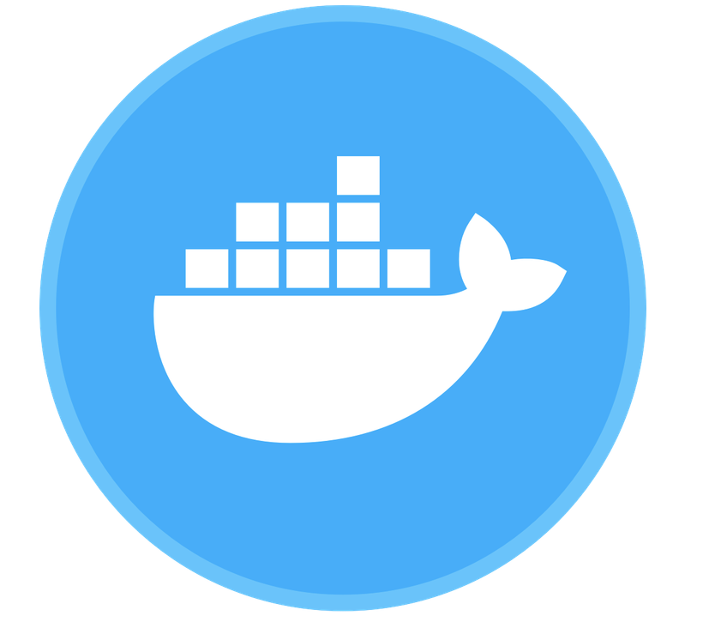
ContentMine Tools
scrape
clean
annotate
display
framework: ami + CProject data
scrapers: getpapers, Ferret, curl, scrapy
cleaners: PDFBox, Tidy/Jsoup, etc. Grobid
transformers: xml2html, ami ocr, KNIME
dictionaries: ami dictionary
indexing and annotation: Solr, ami
Analysis and display: R, KNIME

Slide 40
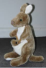
abstract
Captioned
Figures
methods
Fig. 1
MINING
with sections
and dictionaries
HTML tables
references
abstract
Captioned
Figures
Dict A
Fig. 1
Image
Caption
methods
HTML tables
Dict B
references
Table
Caption
[W3C Annotation / https://hypothes.is/ ]

Slide 41
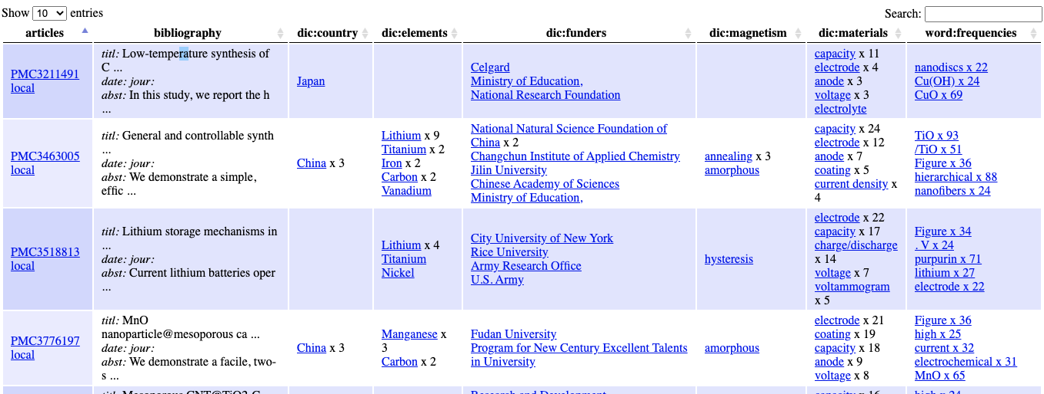
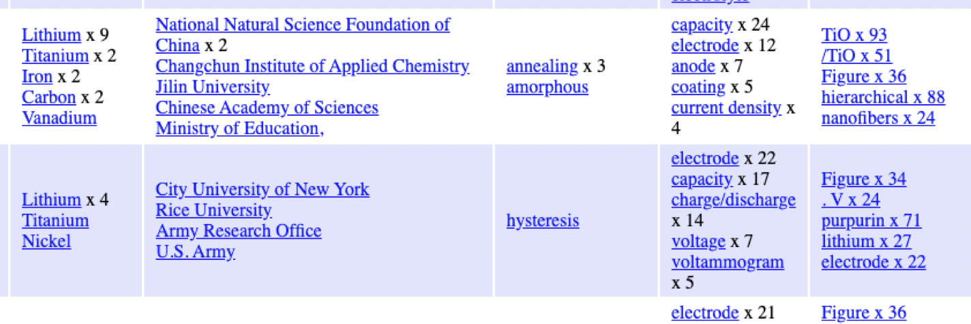
Dashboard of 200 articles searched with 5 dictionaries
biblio
country
element
funder
magnetism
battery

Slide 42
Dashboard of 200 articles searched with 5 dictionaries
biblio
country
element
funder
magnetism
battery
Computable Reusable Objects

Slide 43
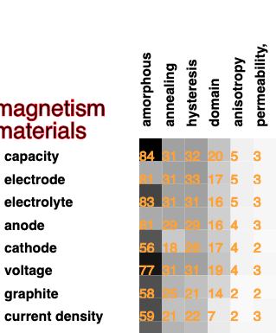
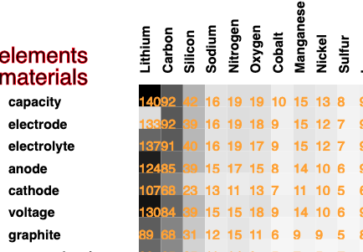
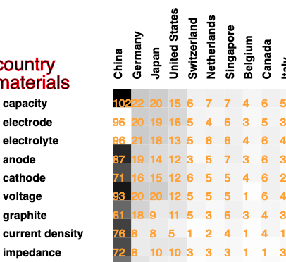
Downstream Computation:
Co-occurrence of words

Slide 44
Mining images with ontologies

Slide 45
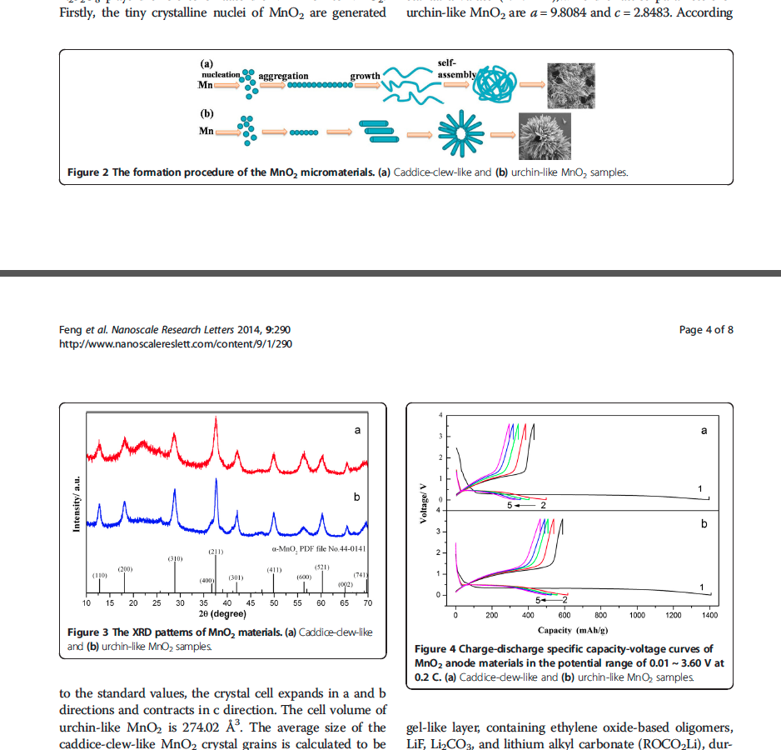
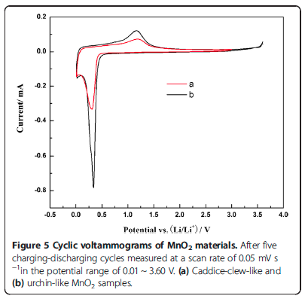
Can we get anything useful with automatic tools?
Work with Matthew Dunstan, Cambridge –
Cyclic voltammetry of battery materials

Slide 46
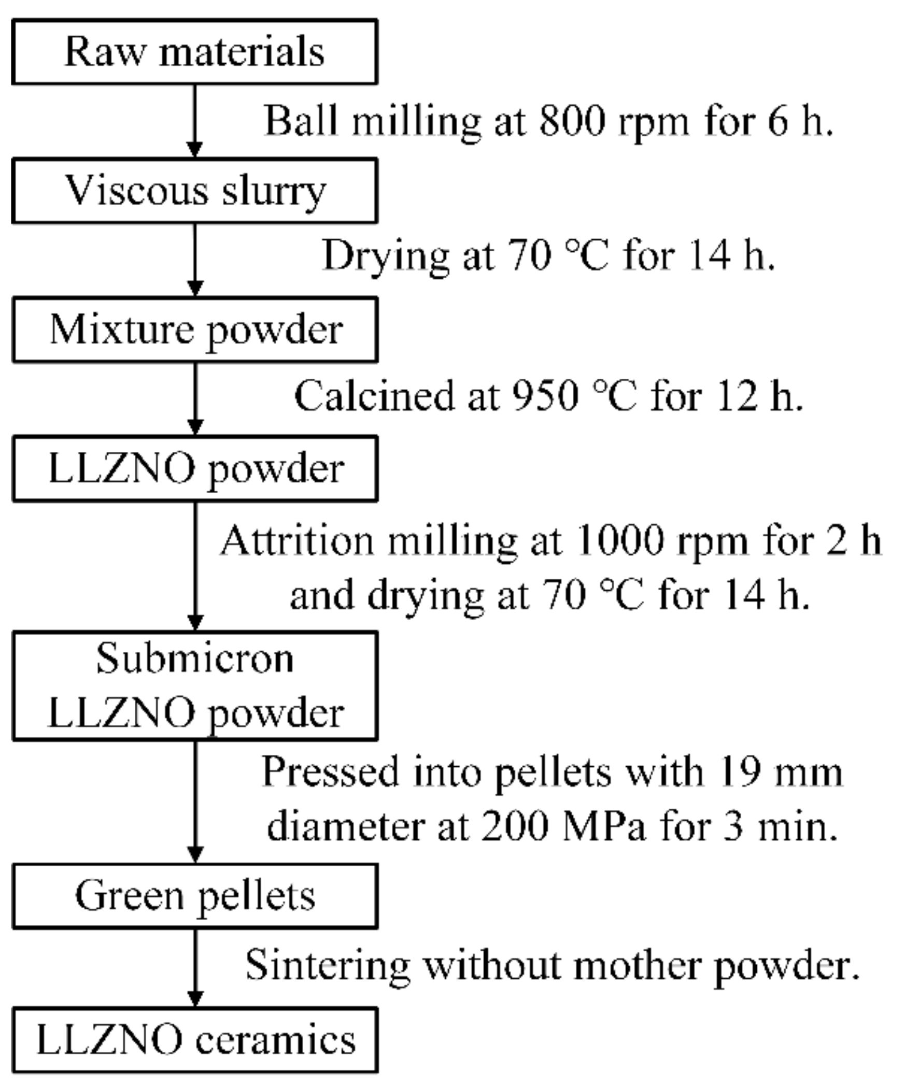
Mining text from images with Tesseract
Raw materials
Ball milling at 800 rpm for 6 h.
Drying at 70 °C for 14h.
Mixture powder
Calcined at 950 °C for 12 h.
LLZNO powder
Attrition milling at 1000 rpm for 2 h and
drying at 70 °C for 14 h.
Submicron LLZNO powder
Pressed into pellets with 19 mm diameter at
200 MPa for 3 min.
Green pellets
Sintering without mother powder.
LLZNO ceramics
Figure
Extracted text

Slide 47
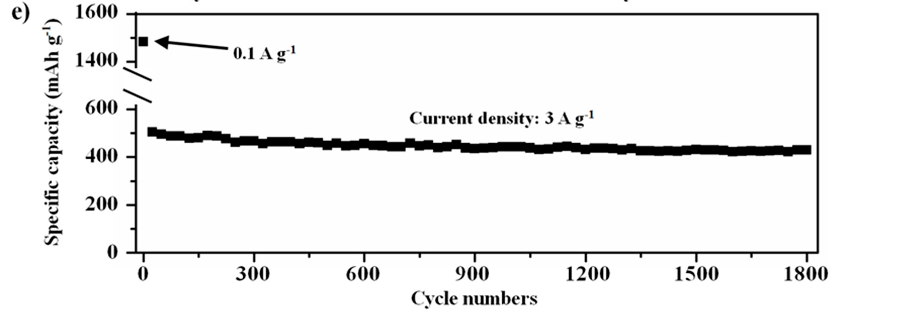
Mining data from plots
1600
1400
600
400
200
0
Current density: 3 Ag?
Specific capacity (mAh g!
0 300 600 900 1200 1500 1800
Cycle numbers
An ontology with units would easily fix the errors

Slide 48
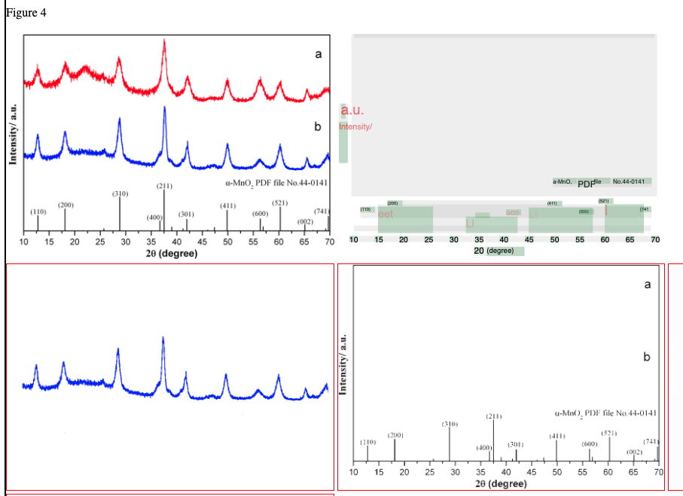
Extraction of data from diagrams

Slide 49
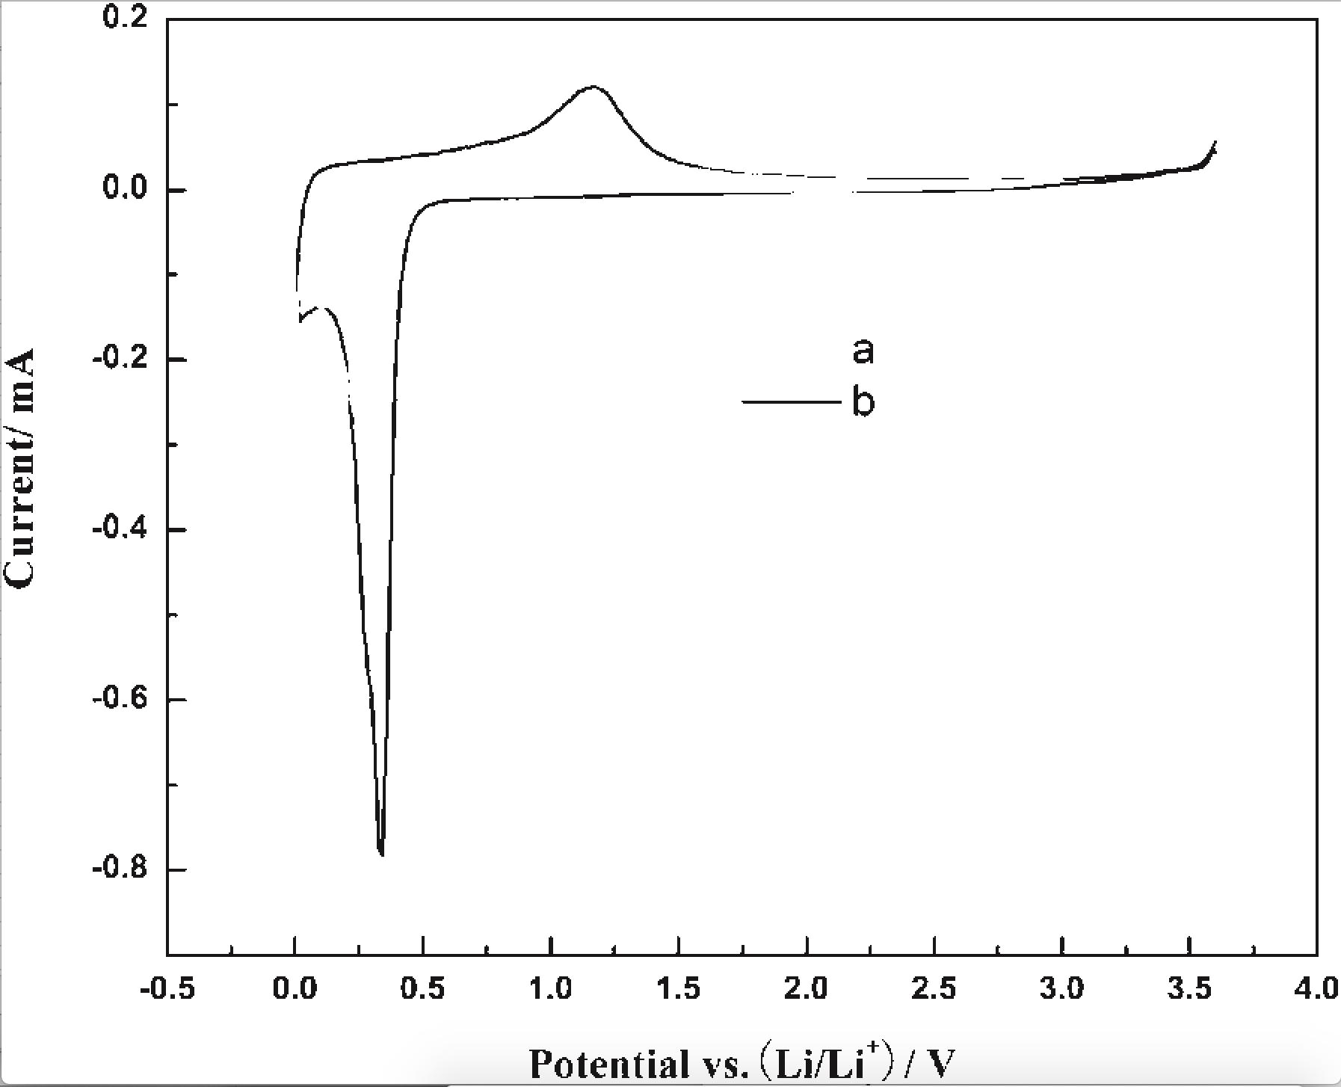
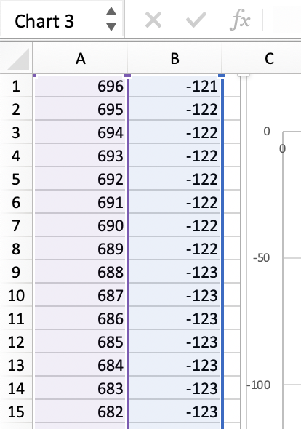
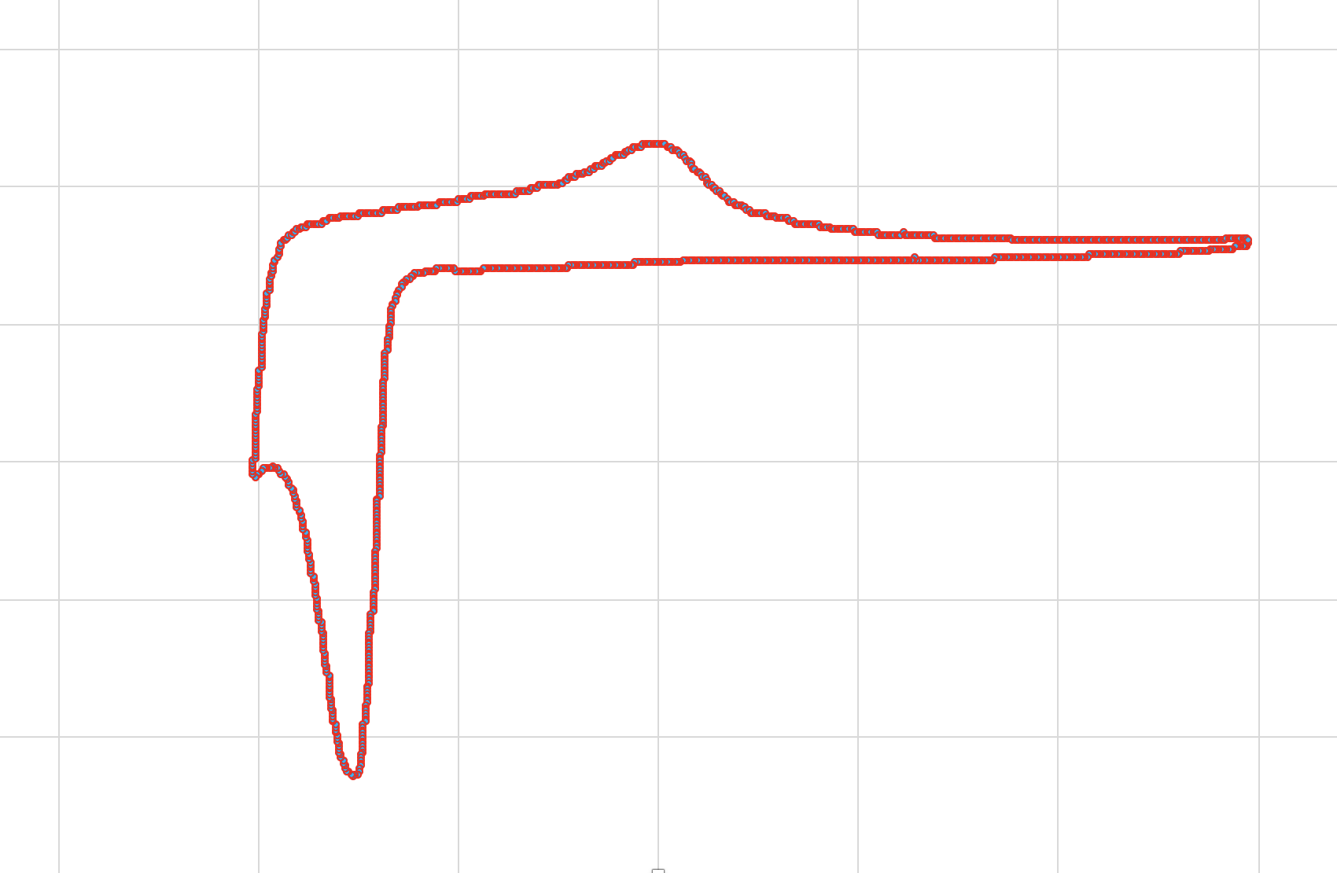
Extraction of data from diagrams
ami-image
ami-pixel

Slide 50
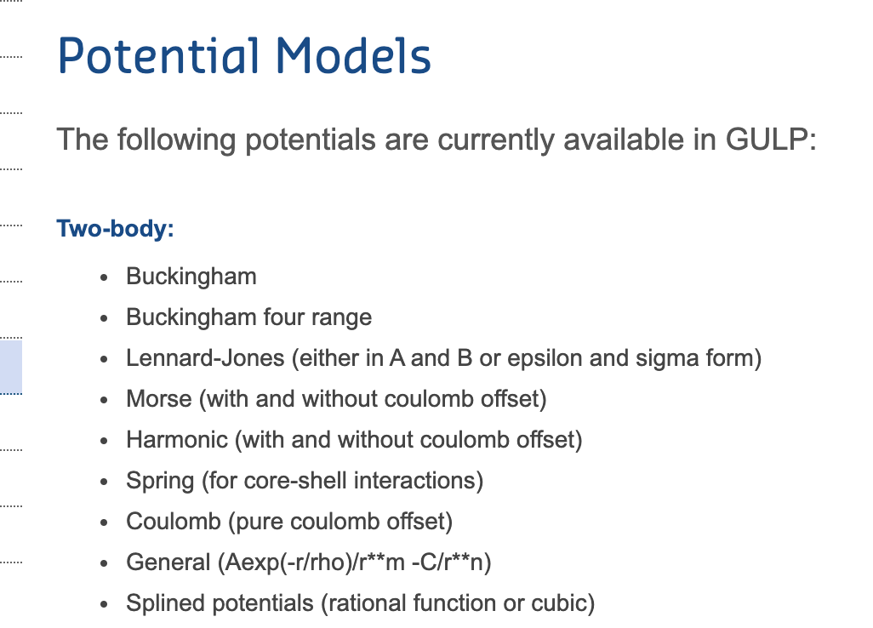
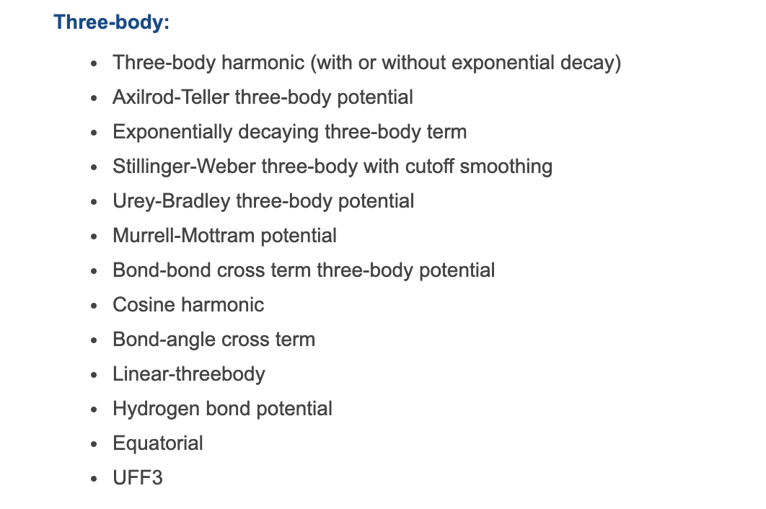
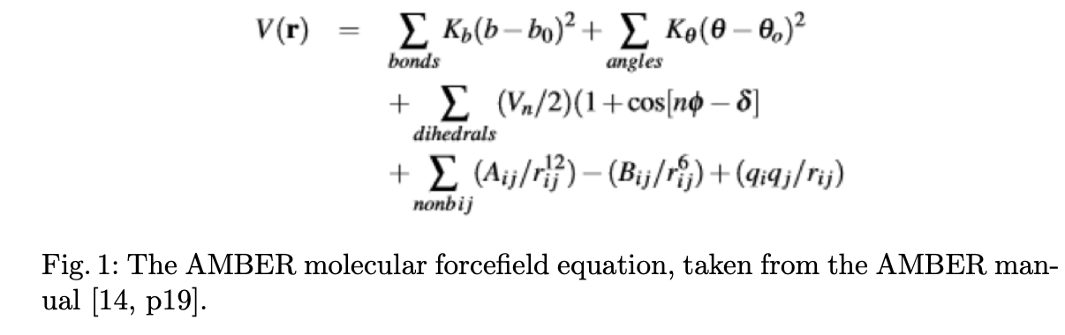
Force fields need a computable ontology

Slide 51
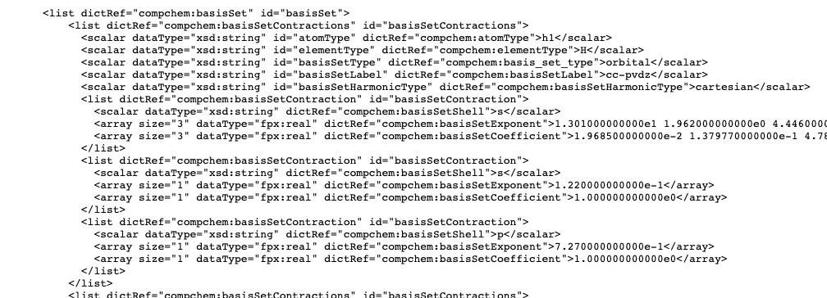
Chemical Markup Language (CML) + dictionaries supports
chemistry as a computable ontology
CompChem Logfile
Reactions
Spectra
Crystallography and nano
Polymers
Computational chemistry

Slide 52
CML + dictionaries supports
chemistry as a computable ontology
CompChem Logfile
(VASP, CASTEP, etc…
Computable Reusable Object Narrative
Reactions
Spectra
Crystallography and nano
Polymers
Computational chemistry

Slide 53
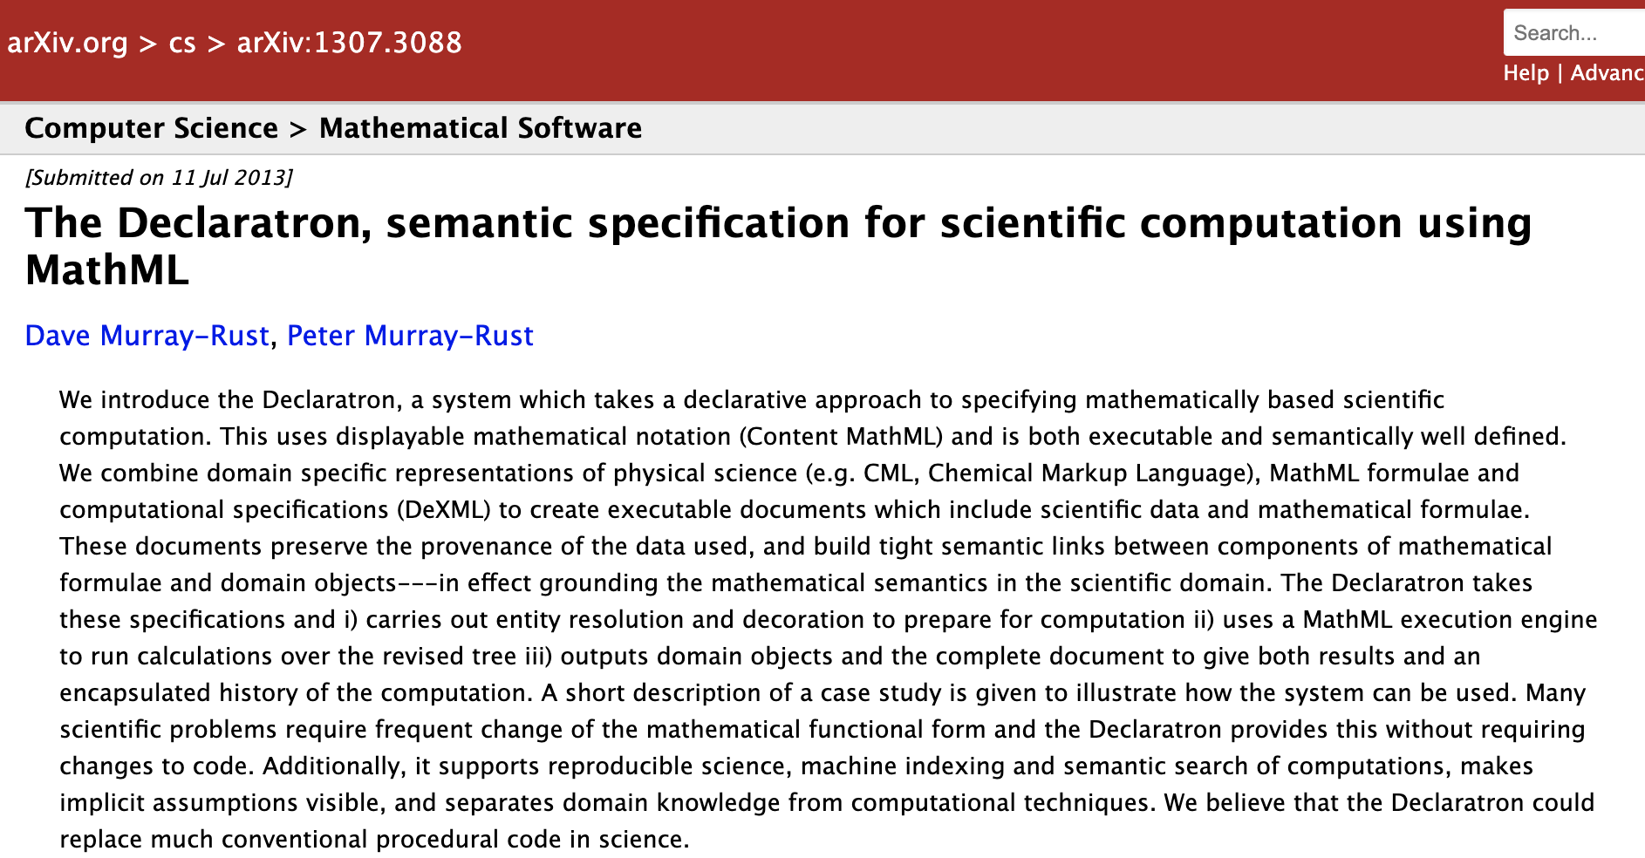
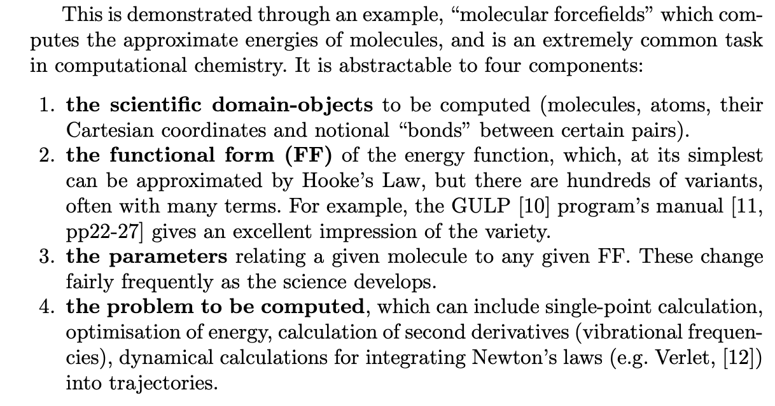

Slide 54
Computable Reusable Object Narrative

Slide 56

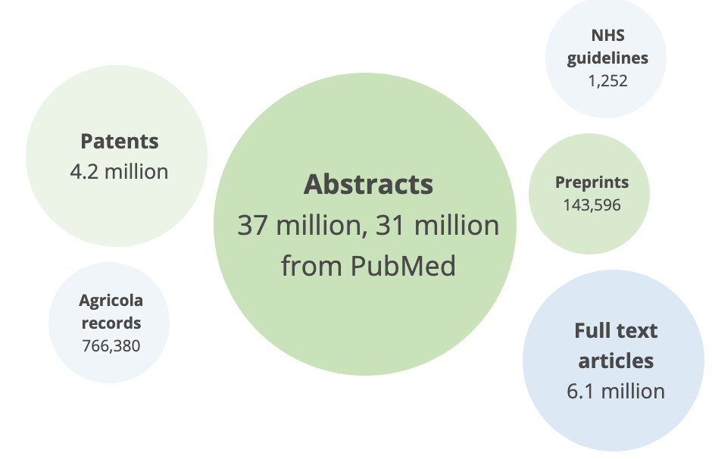




Free Document Sources
4,700,000 abstracts
50,000 preprints
100,000 Theses
Mexico, Latin America
And your archive?
https://doaj.org
https://biorxiv.org
https://medrxiv.org
https://europepmc.org
https://www.redalyc.org/
https://ethos.bl.uk/Home.do

Slide 57
UK Theses (EThOS)
Andy Jackson
A full-text search API to find relevant theses.
data from the EThOS service and the tools of the UK Web Archive -> full-text search API to find relevant theses.
1: Searching eTheses for the openVirus project
2: Bringing Metadata & Full-text Together
This notebook illustrates how to use the API

Slide 58
Thanks:
Mathew Dunstan: Batteries
Shweata N Hegde: word extractions
Ayusg Garg: pygetpapers
Lezan Hawizy: ChemicalTagger
Daniel Lowe: OPSIN
All tools (mining, ontologies, etc.) are Open.
Happy to collaborate.
pm286@cam.ac.uk
https://github.com/petermr : many repositories

